Slide 1
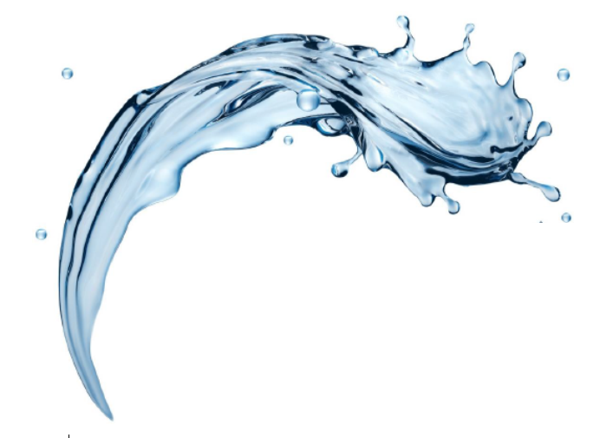

FilterSorb SP3
Health Benefits of SP3:
Part VII
-by Deepak Chopra
1

Slide 2
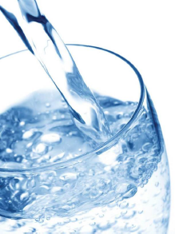

Health Benefits of SP3 Mineral Waters
With 100 properties
In
Defense Of Carbon Dioxide made by ->
3
S
P
Natural
Mineral Water
Minerals that occur naturally in Groundwater, City water or pumped from a well. Mineral that are dissolved in Natural Carbon Dioxide and not Made artificially by adding minerals and carbonated.
Calcium Carbonate (CaCO₃)
Magnesium Carbonate (MgCO₃)
Mineral Water means
And in water as TEMPORARY Hardness Ca(HCO₃)₂

Slide 3

Filtersorb® SP3
is known to Treat Temporary Hardness just in seconds!
Ca(HCO₃)₂ ⇒ Calcium/magnesium carbonates + pure water + carbon dioxide
To make artificially temporary hard water you have to add Calcium/Magnesium carbonates and dissolve them with carbon dioxide till it gets clear. Without CO2 (Carbon dioxide) the water will stay milky.
Why is “Natural Mineral” Water
Good for You?
Why Calcium and Magnesiumincluding Carbon dioxide (CO2) are one of the most important substances on Earth?
And:
Humans •
Animals •
And all Plants on this Earth •
3
S
P

Slide 4
Scientific Facts
CO₂ as,
Scientific FACT
Ca²⁺ as,
Scientific FACT
Mg²⁺ as,
Scientific FACT
SP3 Water does much more than just hydrate you. In scientific fact, it helps to develop strong bones, healthy heart and nervous system, without adding any calories or unnecessary sodium in your diet. Perhaps the biggest Myth about “Natural” Mineral Water is that it is only made by FILTERSORB SP3 Systems.
And it is a “Scientific Fact” that all TAP waters in the world contains enough dissolved minerals to satisfy the
“DEFINITION OF MINERAL WATER” Worldwide it is by “LAW” that any “MINERAL WATER” must contain at least 250 mg/L (min.) and more healthy mineral water up to 350 mg/L of dissolved solids without adding anything artificially.
3
S
P

Slide 5
Nutrition Facts
Check the Nutrition Facts Panel to Verify What is
in the Water you are drinking
Your body loses water everyday through perspiration, respiration and urination. You need to replenish this water with food beverages. Water is simplest way to replenish these lost fluids, because it is easily absorbed into your system and is used in nearly all CELLULAR processes.
Watch Water®
Hydration
It’s a scientific FACT that water comprises up to 70% of the body weight by an adult MAN or WOMAN.
A simple illustration that Ca/Mg (carbonate) + H2O + CO2 is all very essential to just about everything your body does.
3
S
P

Slide 6
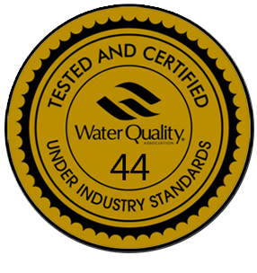
SP3 Water, Safe for Drinking
SP3 Water is SAFE and NATURAL.
SP3 Media is certified to ANSI/NSF 61
certified for by WQA Drinking water applications.
All Bottled water manufacturers remove Calcium and Magnesium from water.
CALCIUM is important for building and maintaining strong bones. SP3 water
contains clinically significant amounts of CALCIUM. Researchers from all over the
world published a STUDY in the “Journal of General Internal Medicine” concluding that TAP Water which is rich in minerals contains 40 to 80 percent of daily allowance for CALCIUM.
Another group of researchers in CANADA published a study in
OSTEOPOROSIS
3
S
P
International

Slide 7
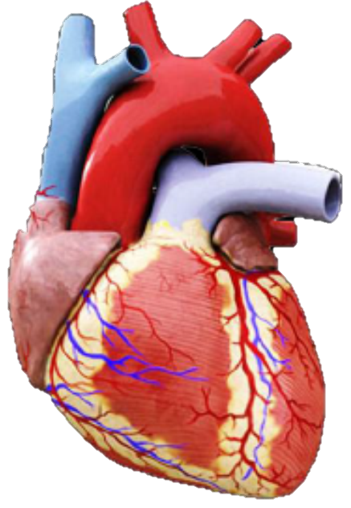
Calcium in SP3 Water
- is just as readily absorbed in your body as the Calcium in foods, such as MILK or other “DAIRY PRODUCTS”. Calcium is available in hard-water and has “hard” taste and feed to water, which is why all bottled water manufacturers REMOVE IT.
Magnesium in SP3 Water
Magnesium is more important for strong bones and cardiac health. It helps Calcium bind together to form bones. Also many hundreds of
“EPIDEMIOLOGICAL STUDIES”
Have found an inverse relationship between
MAGNESIUM INTAKE AND CARDIAC ARRHYTHMIA
3
S
Which is a ischemic heart disease and can cause of sudden death.
P

Slide 8
Magnesium in other words...
All epidemiological studies, they found that certain groups of people consuming high levels of Calcium and Magnesium had much lower chances of acquiring CARDIAC DISEASE than groups of people consuming soft water or high levels of Sodium in water.
The amount of Magnesium in two liters of SP3 mineral-rich water all over the world, may range 15% - 75% of the recommended daily allowance.
Researchers from all over the world found that Magnesium in water is 50% more bio-available than Magnesium in foods. And again, given a SP3 Water and Food source with equivalent amounts of Magnesium, your body will absorb 50 percent more Magnesium from SP3 water than any other food source.
3
S
P

Slide 9
Magnesium in other words... (continued...)
Once again, Mineral water is regulated by the
“FOOD and DRUG ADMISNITRATION”
-and must have at least 250 mg/L and up to 350 mg/L of dissolved solids, collected from a Major Natural Water Sources viz. Ground Water or Surface Water.
It must contain NO ADDED MINERALS
so DRINK SP3 Water and be HEALTHY
Because SP3 water keep these minerals which are essential and great for your health.
3
S
P

Slide 10

Want to read more?
Carbon dioxide constantly leaks into the environment from natural water sources, and that’s good for all
“SCIENTISTS IN THE WORLD”
-All the time!
The bubbles in the glass of SP3 water are made of naturally leaking gad from temporary hardness which is happening for thousands of years. For thousands of years CO2 has been bubbled to the water surface and mixed with air. Plants, animals and human still live on the shores of the lake. So SP3 water, another natural CO2 leak produces the carbonated water that should be packed into
GREEN BOTTLES
-And SOLD ALL OVER THE WORLD
Coming Next: Application of FILTERSORB SP3 in
Agriculture
Plants
3
End of Part VII
S
In Germany, for example, scientists have found that plants grow
better with natural CO₂ in water
Thanks for reading!
P

Slide 11
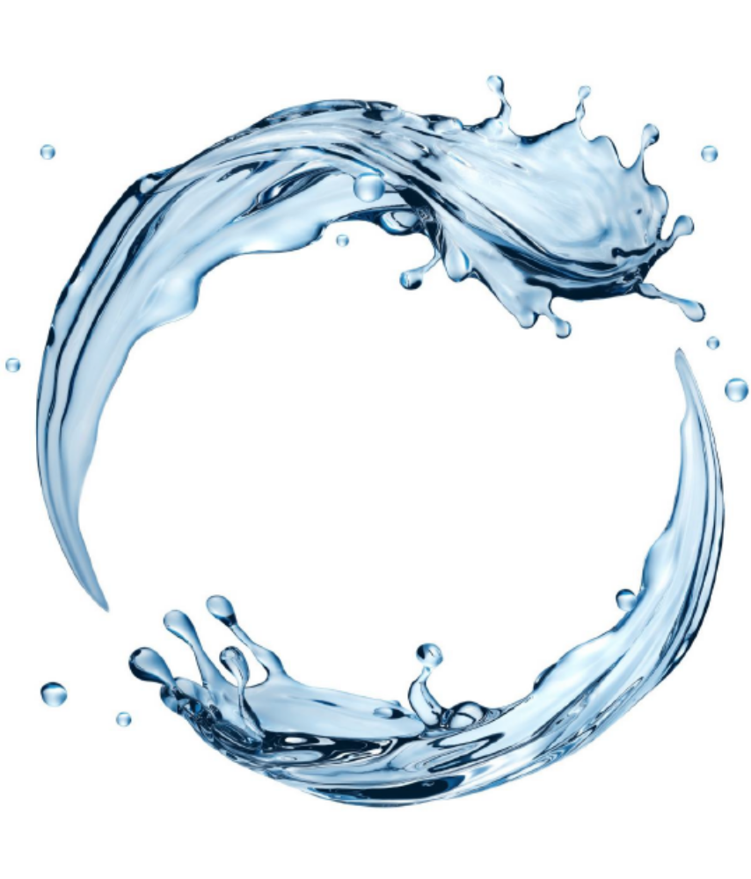

Watch Water® GmbH
Fahrlachstraße 14
68165 Mannheim
Germany
www.watchwater.de
info@watchwater.de
+49 (o)621 87951-0

